Slide 1


Unlocking Mobile Market Trends: A Data-Driven Analysis for Decision-Makers
This presentation offers a deep dive into the Indian mobile market, leveraging comprehensive data from Flipkart. across various price segments, and the most common mobile specifications. Our goal is to provide actionable insights for business analysts and decision-makers, facilitating informed strategic planning and product development.
Purushottam Mitra
E-mail: pmitra620@gmail.com
Ph. No. +91-7002429620

Slide 2
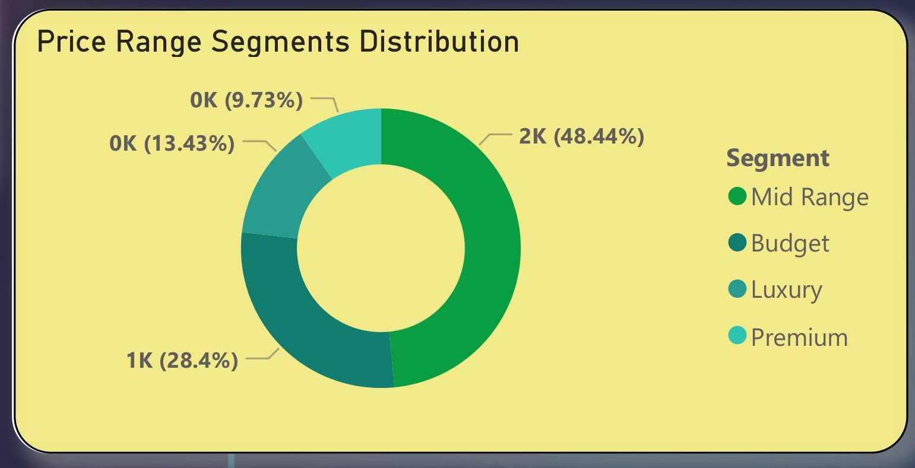
Demystifying Price Segments in the Indian Mobile Market
I have divided mobile phones into four price-based segments using their selling price.
Phones priced up to ₹10,000 are labeled Budget,
those between ₹10,001 and ₹29,999 are Mid Range,
prices from ₹30,000 to ₹49,999 are Premium,
and anything ₹50,000 or above falls under the Luxury segment.
This segmentation helps in analyzing product distribution and customer targeting across different price levels
🔍 Insight: The market is almost evenly distributed between Mid Range and Premium.
Low-range devices still represent a significant share (~28%).
Low Range
Mid Range
Premium
Our analysis categorizes mobile phones into three distinct price segments: Low Range (less than ₹10,000), Mid Range (₹10,000 – ₹19,999), and Premium (₹20,000 and above). The data reveals a near-even distribution across the Mid Range and Premium segments, each commanding over 1,100 product listings. While the Low Range segment holds a significant 28% share, the market's heart lies in the higher tiers, indicating strong consumer purchasing power for more feature-rich devices.

Slide 3
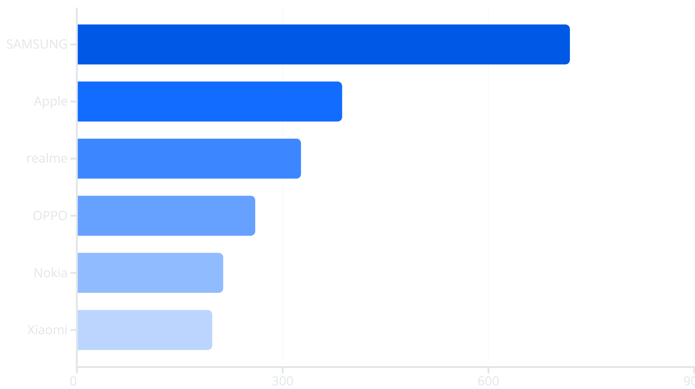
Brand Dominance: Who Leads the Indian Mobile Market?
🔍 Insight:
Samsung dominates with the widest catalog across segments.
Brands like Apple and realme also offer strong lineups.
Samsung firmly holds the top position in the Indian mobile market, offering the most extensive product catalog with 719 distinct models. This widespread offering positions Samsung as a dominant force. Following Samsung, Apple and realme demonstrate strong product lineups, contributing significantly to market variety. This diversity in brand offerings underscores a competitive landscape, with major players vying for consumer attention across various segments.

Slide 4

Brand Strategy: Catering to Every Price Segment
Low Range
Mid Range
Premium
SAMSUNG
✅
✅
✅
OPPO
✅
✅
✅
Xiaomi
✅
✅
✅
realme
✅
✅
✅
Nokia
✅
✅
✅
Motorola
✅
✅
✅
Our analysis reveals that several key brands, including Samsung, OPPO, Xiaomi, realme, Nokia, and Motorola, have adopted a comprehensive product strategy, catering to consumers across all three price segments: low, mid, and premium. This broad market coverage highlights their commitment to capturing a diverse customer base. In contrast, premium brands like Apple strategically focus exclusively on the high-end market, underscoring distinct business models within the industry.
🔍 Insight: Samsung and realme cater to every consumer segment, indicating a broad product strategy. Brands like Apple serve only the Premium market.

Slide 5
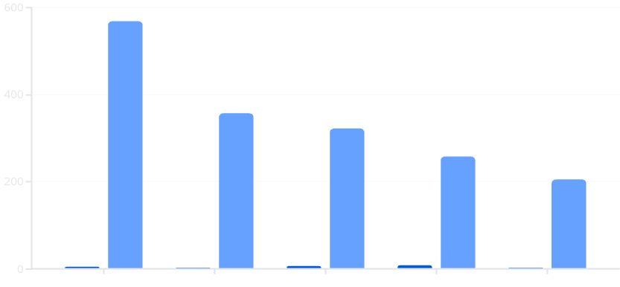
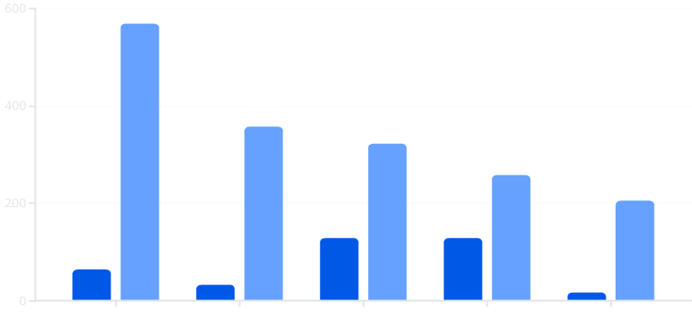
Most Common Specifications: RAM and Storage Trends
RAM (GB)
Products
Storage (GB)
Products
Our deep dive into mobile specifications reveals that 4GB RAM and 64GB storage are the most frequently offered configurations across various brands, likely hitting a sweet spot for the mid-range market. Furthermore, 6GB/128GB and 8GB/128GB combinations are highly prevalent in the premium and upper mid-range segments, reflecting consumer demand for higher performance and storage capacity. These trends provide crucial insights into manufacturer strategies and consumer preferences.

Slide 6





Top Specification Combinations by Product Count
4 GB RAM / 64 GB Storage
568 Products
3 GB RAM / 32 GB Storage
357 Products
6 GB RAM / 128 GB Storage
323 Products
8 GB RAM / 128 GB Storage
258 Products
2 GB RAM / 16 GB Storage
205 Products
Analyzing the most common specification combinations reveals clear market preferences. The 4GB RAM / 64GB Storage configuration leads with 568 products, establishing itself as the most popular choice, likely catering to the broad mid-range consumer base. Configurations like 6GB/128GB and 8GB/128GB are also highly sought after, reflecting the premium and upper-mid segments' demand for enhanced performance and storage. These insights are crucial for understanding consumer trends and optimizing product development.

Slide 7




Key Takeaways: Strategic Insights for the Mobile Market
Samsung's Market Leadership
Dominant Market Segments
Samsung stands out as the most diverse brand, with extensive offerings across all price segments and a wide range of specifications.
The mid-range and premium segments are the primary drivers of the Flipkart marketplace, indicating a strong consumer appetite for higher-value devices.
Popular Specification Combinations
Brand Positioning
The 4GB/64GB configuration remains the most popular, particularly for budget and mid-tier phones, while higher specifications cater to premium demands.
Apple is firmly positioned in the premium category, whereas brands like Infinix and GIONEE primarily focus on the budget-conscious consumer, highlighting varied strategic approaches.
These key takeaways provide a foundational understanding of the current mobile market landscape. Samsung's broad appeal, the dominance of mid-range and premium segments, and the clear preference for specific RAM/storage combinations underscore the dynamic nature of consumer demand and competitive strategies.

Slide 8
Recommendations for Market Expansion and Improvement
Data Consistency & Dashboarding
Segment-Specific Cataloging
Spec-Based Promotions
Ensure consistent product specifications (RAM, Storage) to improve data quality and user experience. Develop an interactive Power BI dashboard with key filters for dynamic analysis.
Brand Expansion Strategy
Focus marketing and sales campaigns on the most popular configurations, such as 4GB/64GB and 6GB/128GB, to maximize sales effectiveness.
Implement the established price segmentation model for enhanced filtering and search experiences on e-commerce platforms, improving user navigation.
Mid-tier brands should explore opportunities to enter the premium market, while premium brands could consider introducing budget variants to capture emerging market shares.
Implementing these recommendations will not only drive strategic growth but also enhance the overall user experience and data integrity within the mobile market. By leveraging these insights, businesses can make more informed decisions, optimize their product offerings, and strengthen their market position.

